Slide 1
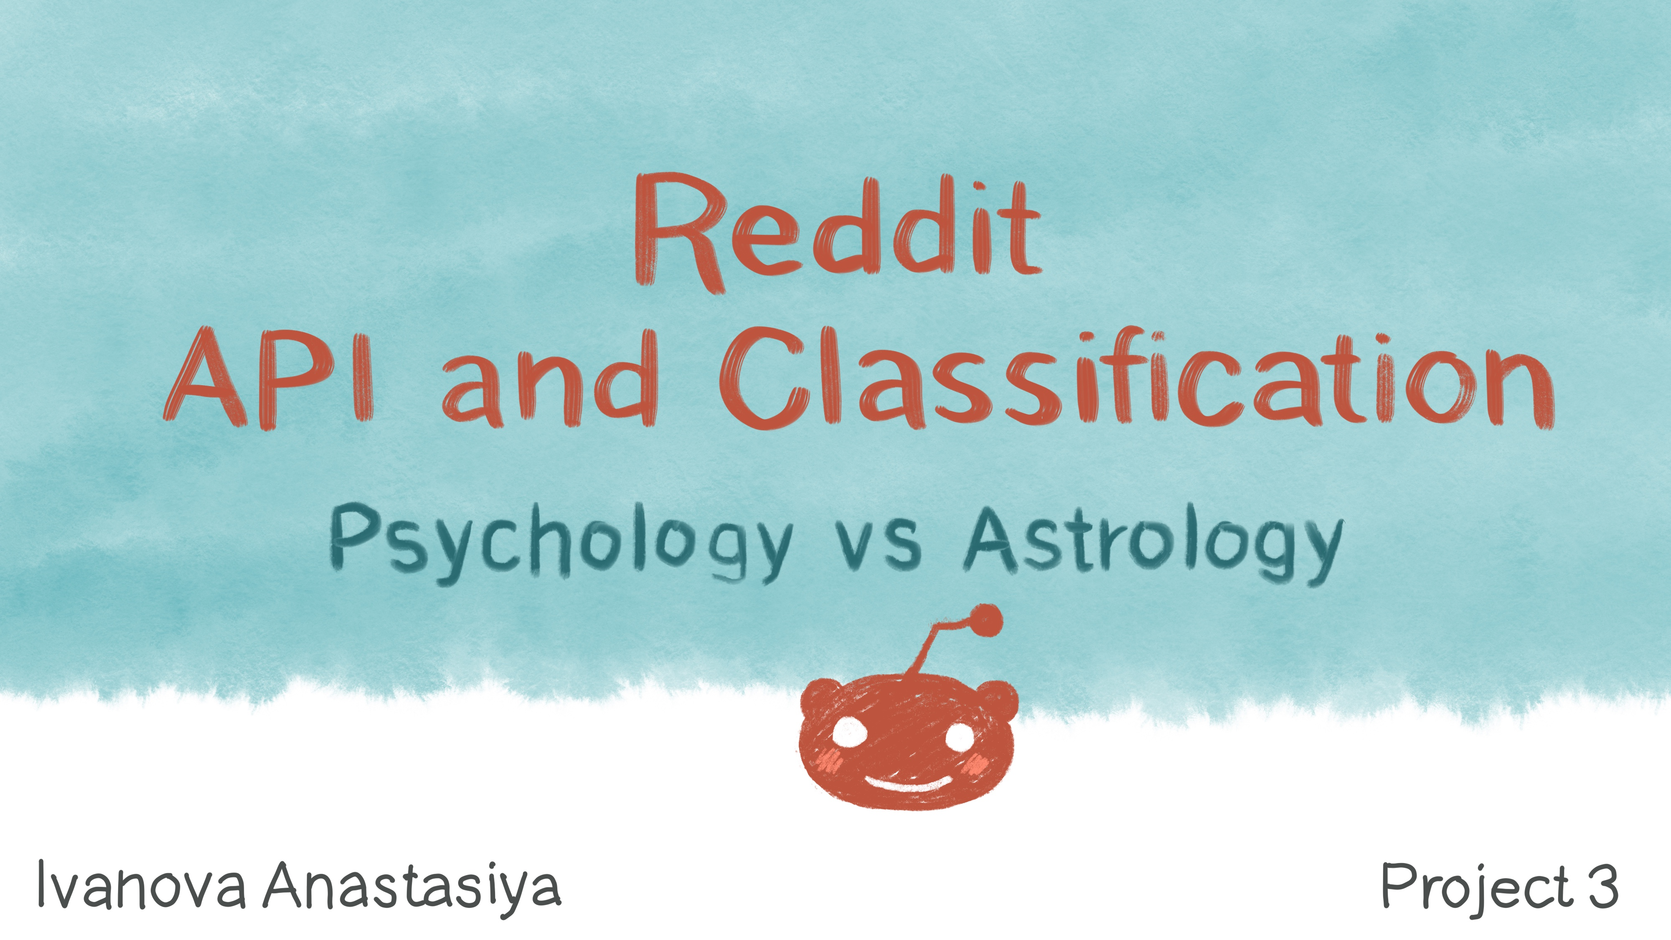

Slide 2
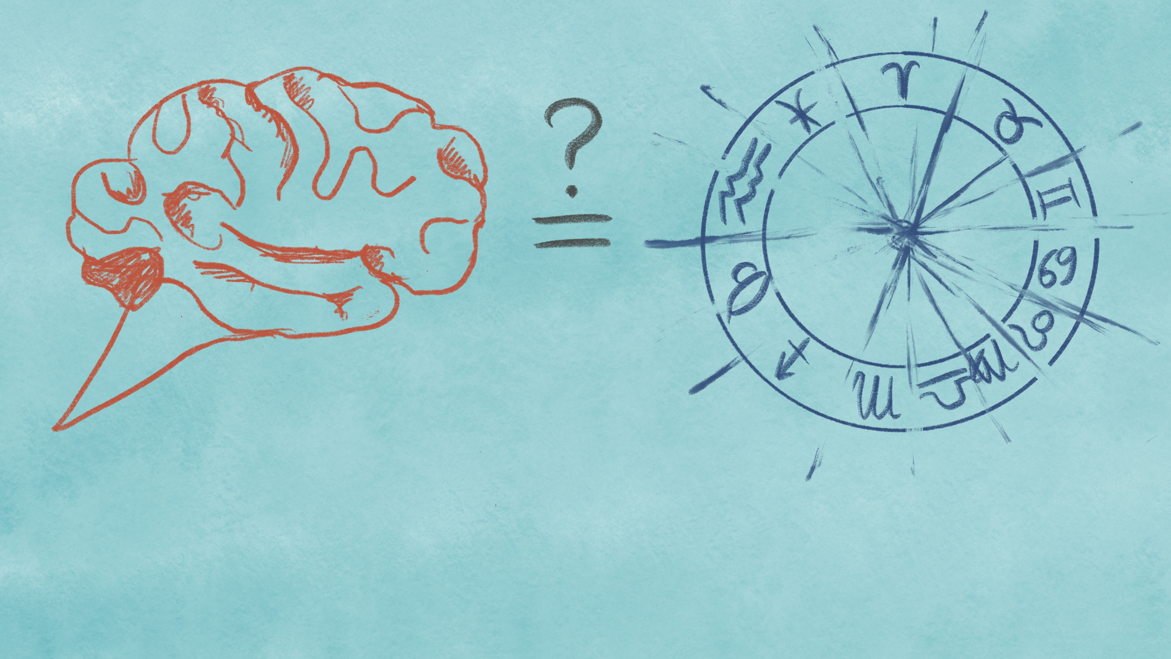
Some people claim that psychology and astrology are very similar fields
Others think that psychology is science while astrology is a pseudoscience and they do not have any close relationship.

Slide 3

Questions

Slide 4

Answer the following questions:
Distinguish
Distinguish post about psychology and astrology based on the text?
Vocabulary
Do psychology and astrology have a specific vocabulary?
Community
Does the activity of the community members in subreddits differ?
Scientific
Do psychological posts contain scientific words?

Slide 5
Evaluation of success

Slide 6
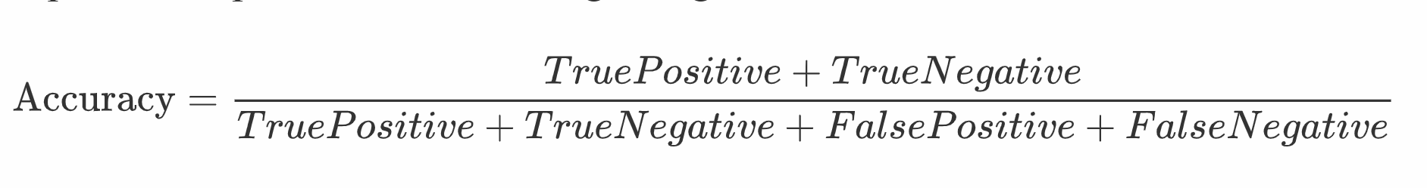

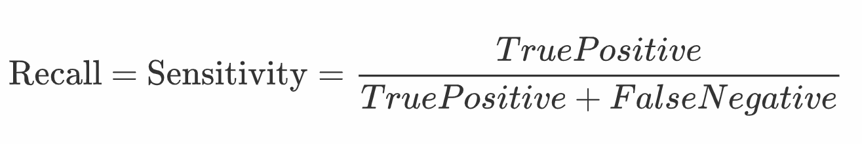
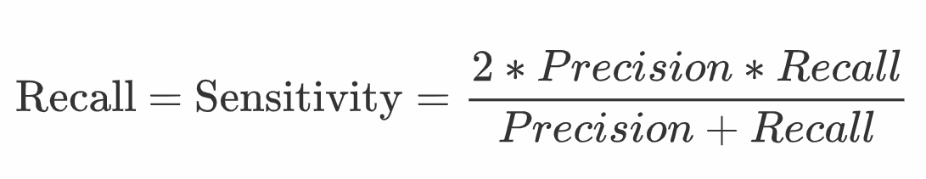
Evaluation

Slide 7

Exploratory Data Analysis

Slide 8
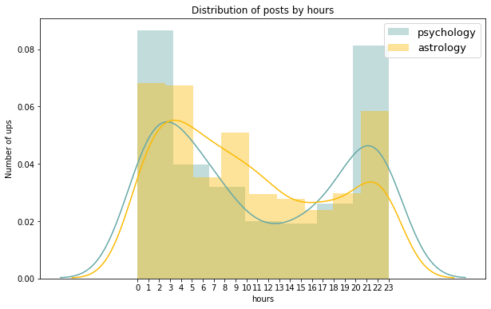
Posts in the dataset were published between
2020-05-13 21:05:19 and 2020-02-28 05:16:12.

Slide 9
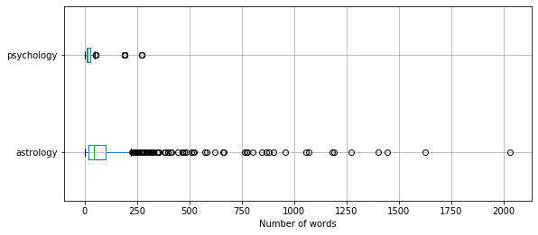
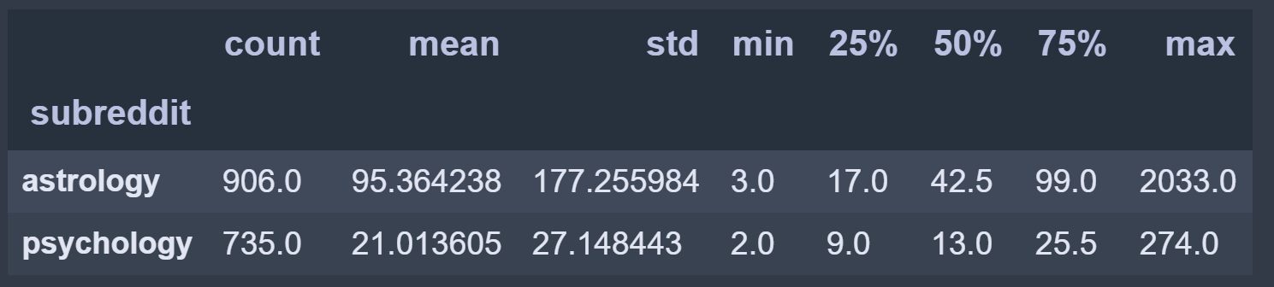
Astrology subreddit's posts have significantly more words than Psychology.

Slide 10
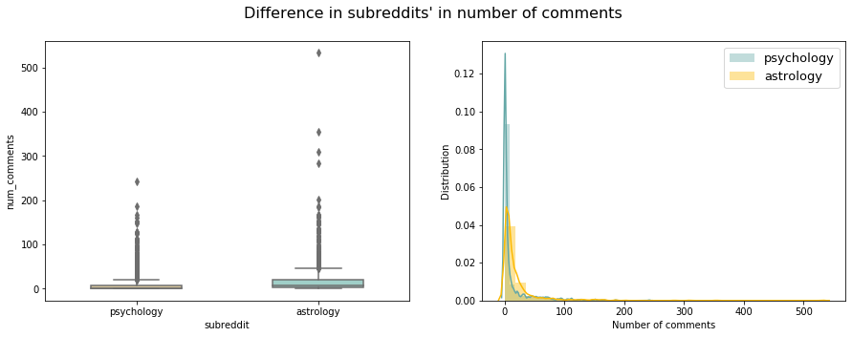
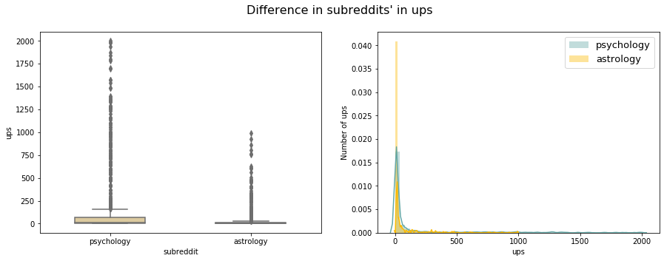
Difference in subreddits' in number of comments
Difference in subreddits' in ups

Slide 11
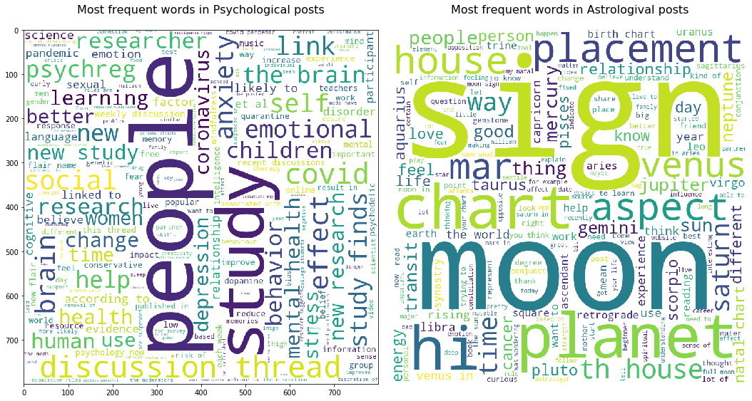

Slide 12
Evaluation

Slide 13
Modeling

Slide 14
TfidfVectorizer LogisticRegression Best model
Vectorizer | Model | Cross_val_scores train (accuracy) | Train accuracy | Test accuracy | Test precision | Test recall | Test f1
TfidfVectorizer | MultinomialNB | 0.902, 0.927, 0.915, 0.909, 0.884 | 0.993 | 0.921 | 0.984 | 0.837 | 0.904
TfidfVectorizer | LogisticRegression | 0.97, 0.933, 0.945, 0.957, 0.896 | 0.998 | 0.945 | 0.924 | 0.956 | 0.94
TfidfVectorizer | KNeighborsClassifier | 0.866, 0.89, 0.909, 0.884, 0.878 | 0.913 | 0.904 | 0.965 | 0.815 | 0.883

Slide 15
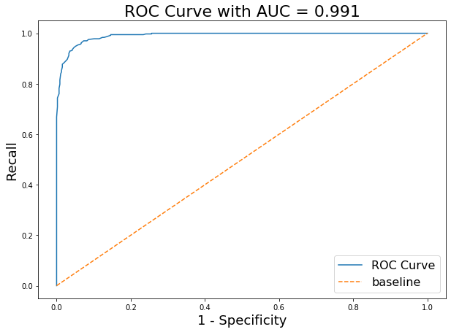
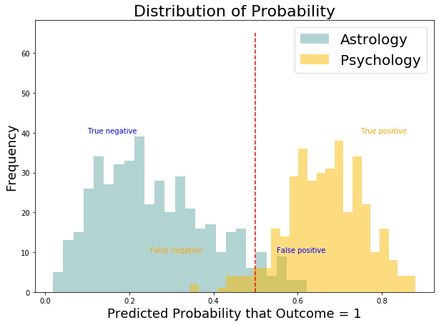
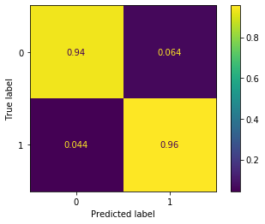

Slide 16
Word coefficients

Slide 17

word | coef | exp_coef
chart | -2.601682 | 0.074149
moon | -2.584769 | 0.075414
house | -2.293753 | 0.100887
sign | -2.131883 | 0.118614
know | -1.943406 | 0.143215
saturn | -1.714446 | 0.180063
planets | -1.673879 | 0.187518
venus | -1.646902 | 0.192646
placements | -1.471980 | 0.229471
like | -1.425828 | 0.240309
mars | -1.415241 | 0.242867
signs | -1.285386 | 0.276544
aspects | -1.277923 | 0.278615
think | -1.239005 | 0.289672
sun | -1.220196 | 0.295172

Slide 18

word | coef | exp_coef
brain | 1.825749 | 6.207442
study | 1.793729 | 6.011832
covid | 1.593490 | 4.920891
psychreg | 1.192753 | 3.296143
research | 1.191482 | 3.291956
social | 1.050195 | 2.858208
finds | 0.987221 | 2.683765
health | 0.967211 | 2.630598
people | 0.867871 | 2.381834
mental | 0.830564 | 2.294612
children | 0.808631 | 2.244833
cognitive | 0.799526 | 2.224487
anxiety | 0.790690 | 2.204918
behavior | 0.773993 | 2.168407
women | 0.712393 | 2.038864

Slide 19
Misclassification

Slide 20
astr_proba | psy_proba | subred | predict | text | num_comments | ups | len_text
0.468920 | 0.531080 | 0 | 1 | my university paid me to study astrology hi ev... | 16 | 68 | 154
0.404068 | 0.595932 | 0 | 1 | an astrological saga i am writing | 1 | 1 | 6
0.393937 | 0.606063 | 0 | 1 | future of the single european currency what wi... | 5 | 1 | 17
0.487269 | 0.512731 | 0 | 1 | trump s impeachment and the eclipses | 1 | 0 | 6
0.449905 | 0.550095 | 0 | 1 | harry styles astrological profile and future a... | 1 | 0 | 13
0.468126 | 0.531874 | 0 | 1 | til that mutable has that same root as mutate ... | 20 | 17 | 11
0.496673 | 0.503327 | 0 | 1 | haha well at least we figured out what the thi... | 2 | 2 | 11

Slide 21
astr_proba | psy_proba | subred | predict | text | num_comments | ups | len_text
0.527827 | 0.472173 | 1 | 0 | time to kill the scientific zombie that is the... | 0 | 2 | 13
0.510812 | 0.489188 | 1 | 0 | what a friend is upset validating their feelin... | 6 | 21 | 16
0.639311 | 0.360689 | 1 | 0 | connectedness to nature is good for us and for... | 0 | 12 | 11
0.534877 | 0.465123 | 1 | 0 | did mayor pete s youthful face lose him votes ... | 0 | 2 | 19
0.575771 | 0.424229 | 1 | 0 | free bathrooms in starbucks cellphone location... | 6 | 6 | 28
0.552107 | 0.447893 | 1 | 0 | are you big enough to apologize | 0 | 11 | 6
0.547903 | 0.452097 | 1 | 0 | looking at your phone at work might make you e... | 44 | 799 | 12

Slide 22
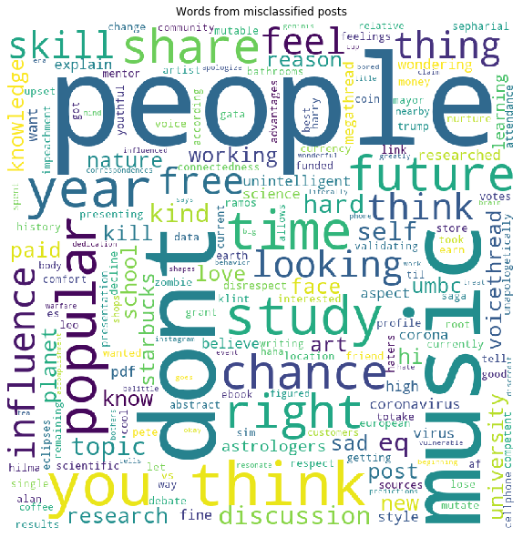

Slide 23
Conclusion

Slide 24
820 new posts from two subreddits: r/psychology/ and r/astrology/
were classified with accuracy of 94.5 %.
Predictive words of subreddits where
identified based on a coefficient of the model.

Slide 25
Answering the questions

Slide 26
Answer the following questions:
Distinguish
Distinguish post about psychology and astrology based on the text?
Vocabulary
Do psychology and astrology have a specific vocabulary?
Community
Does the activity of the community members in subreddits differ?
Scientific
Do psychological posts contain scientific words?

Slide 27
Answers:
Is it possible to distinguish post about psychology and astrology based on the text? Yes, it is. Our model classified correctly 94.5 % of new unlabeled posts.
Does the activity of the community members in subreddits differ? Yes, it does:
1.People who write posts for an astrological subreddit prefer to use more words (and sometimes even more than 1000 words) than those who writing posts for a psychological subreddit.
2.Astrological community writing more comments to posts than psychological.
3.Psychological community is more than astrological rates posts with ups. 4.Psychological posts were published later at night than astrological. Morning activity (from 8 to 10 a.m) can be seen for astrological subreddit.
Do psychology and astrology have a specific vocabulary? Yes, they do. Specific words for Psychology: brain, psychreg, social, health, mental, cognitive, anxiety, behavior. Specific words for Astrology: house, sign, saturn, planets, venus, placements, mars, signs, sun.
Do psychological posts contain scientific words? Some words are from general scientific vocabulary which distinguish psychology from astrology: study, research.

Slide 28

Questions?

